Slide 1

5-12-2025
TITLE-
House Price Prediction Using Machine Learning
Technologies: Python, Pandas, NumPy, Scikit-Learn, Matplotlib
Project Domain: Machine Learning / Real-Estate Analytics
Presented by-
Prapti Tiwari
ID-UU252000004
Course-MCA(IBM)
Submitted To-
Samarth Amrute Sir
Page
01

Slide 2
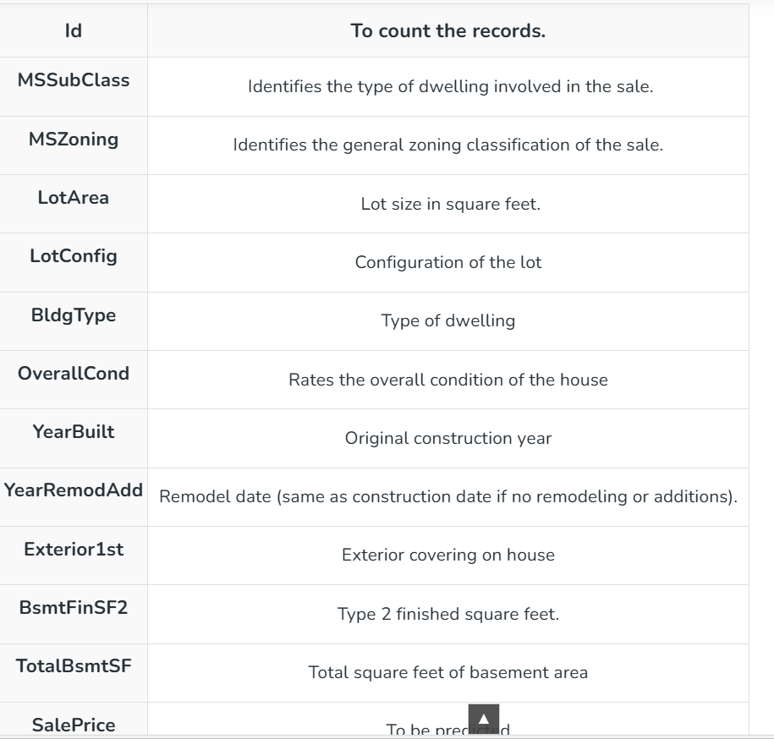

Introduction
This project focuses on building a predictive model capable of estimating house prices based on multiple influencing factors. The real-estate market is highly dynamic, and price variations depend on numerous attributes.
Aim: Develop a data-driven model using Python and ML algorithms to estimate property prices accurately.
The model assists buyers, sellers, and real estate companies with informed decision-making.
Page
02

Slide 3
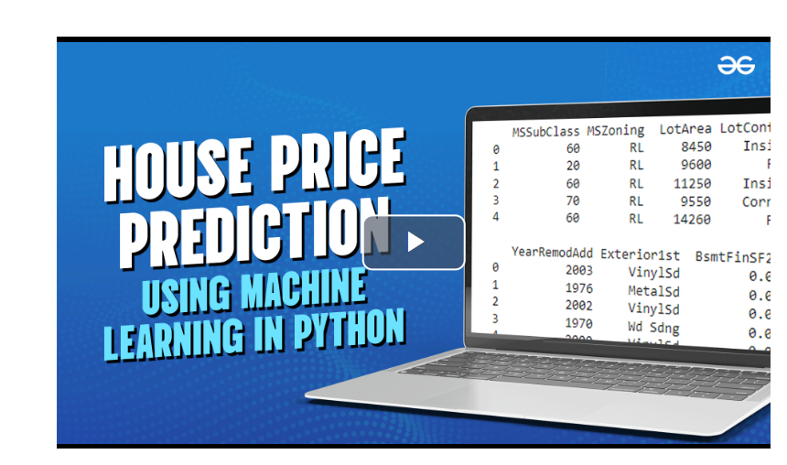

Problem Statement
House prices vary due to factors such as
geographical location, built-up area, number
of rooms, age of property, facilities, and market
conditions
Traditional/manual estimation:
Is time-consuming
Prone to bias
Often inaccurate
Goal: Build an ML-based regression model that learns patterns from historical data and predicts house prices with minimal error.
Page
03

Slide 4

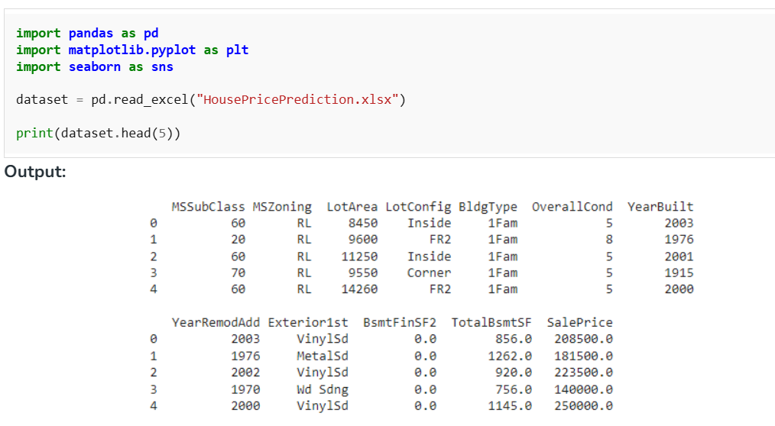
Objectives
of the Project
Analyze a real-estate dataset to understand pricing trends.
Preprocess and clean the data to remove inconsistencies.
Apply multiple machine learning regression algorithms.
Compare model performances using standard evaluation metrics.
Identify the most important features influencing house prices.
Generate accurate price predictions and visualize results.
Page
04

Slide 5
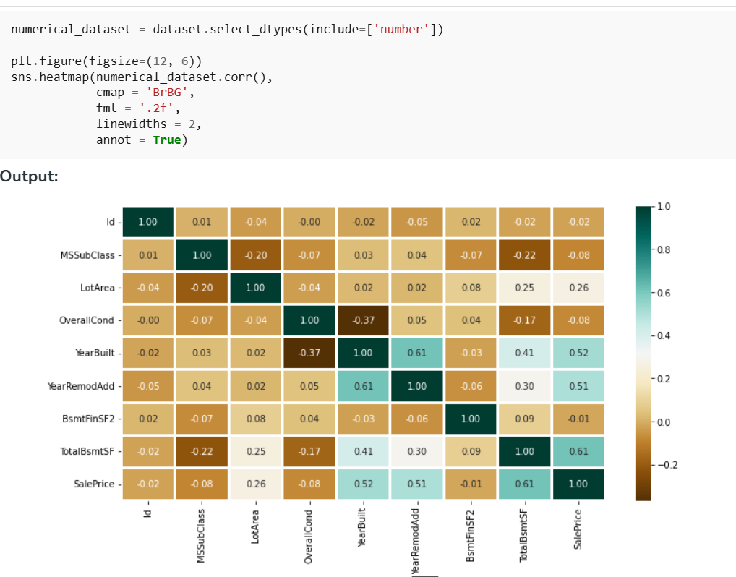
Dataset
Description
The dataset contains real-world housing details with both numerical and categorical features.
Key Features:
Area (sq. ft.)
Number of Bedrooms & Bathrooms
Location & Locality Index
Year Built / Property Age
Amenities (parking, balcony, furnishing, etc.)
Distance from key facilities (schools, markets, transport)
Target Variable: Final Selling Price
The dataset is analyzed for completeness, distribution, and correlations.
Page
05

Slide 6
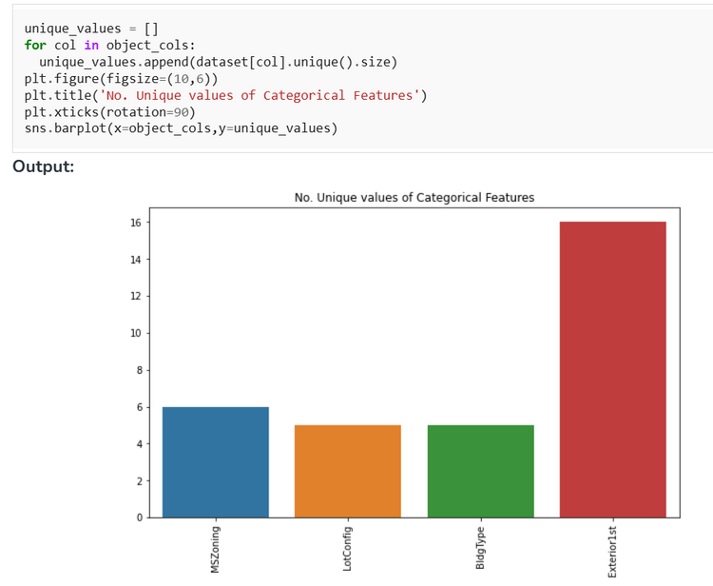
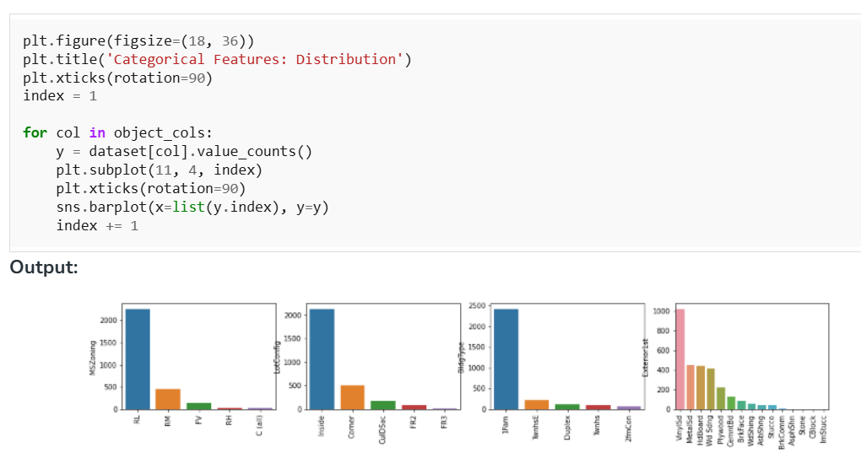
Data
Preprocessing
To ensure the dataset is ML-ready, the following operations are performed:
Handling Missing Values: Replaced using mean/median or removed if excessive.
Encoding Categorical Variables: One-Hot or Label Encoding for textual features.
Scaling Numerical Data: StandardScaler/MinMaxScaler for uniform range.
Outlier Detection: Boxplots & Z-score to remove extreme values.
Train-Test Split: 80% training, 20% testing for model validation.
This step significantly improves the performance and reliability of the model.
Page
06

Slide 7
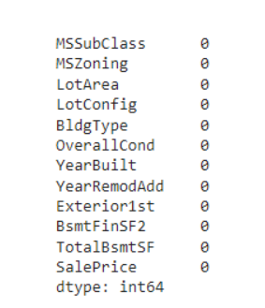
Exploratory Data Analysis (EDA)
EDA helps uncover hidden patterns that drive price changes:
Corelation Heatmap:
Shows relationship between features & price.
Distribution Plots:
Identify skewness and spread of numerical data.
Box Plots:
Reveal outliers affecting prediction accuracy.
Feature Importance:
Determines which attributes strongly influence price (e.g., location, area, rooms).
Insights from EDA guide model selection and performance tuning.
Page
07

Slide 8
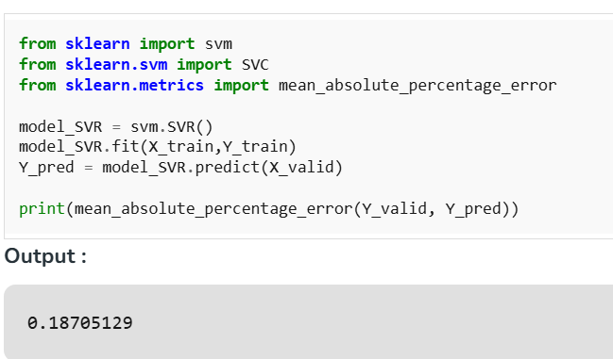
Model Building & Algorithms Used
Multiple regression algorithms are implemented and compared:
Linear Regression: Baseline model for simple relationships.
Decision Tree Regressor: Captures nonlinear patterns.
Random Forest Regressor: Ensemble method with higher accuracy.
XGBoost Regressor: Boosting algorithm offering strong performance and low error.
Hyperparameter tuning improves model accuracy.
The best-performing model is selected based on evaluation metrics.
Page
08

Slide 9
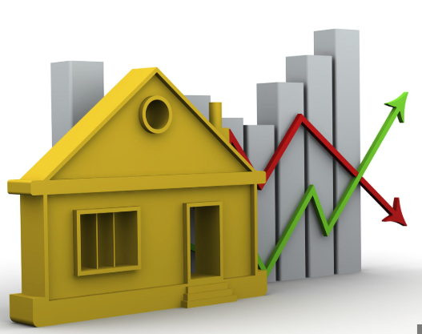
Model Evaluation & Results
The models are evaluated using:
Mean Absolute Error (MAE) – average prediction error
Mean Squared Error (MSE) – penalizes large errors
Root Mean Squared Error (RMSE) – overall model accuracy
R² Score – how well model explains price variance
Result Summary
Random Forest/XGBoost achieves the highest accuracy and lowest error.
Actual vs Predicted price plots show close alignment.
Feature importance graphs highlight top predictors (location, area, rooms).
Page
09

Slide 10
Conclusion And Future Scope
Successfully built an ML model capable of predicting house prices with high accuracy.
Data preprocessing and EDA significantly improved performance.
Ensemble models like Random Forest and XGBoost produced the best results.
Future Enhancements:
Integrating more features (crime rates, local economy, road connectivity).
Deploying as a web application using Flask or Streamlit.
Using deep learning models (ANNs) for larger datasets.
Real-time data integration for dynamic pricing.
Page
10

Slide 11


Thank
You.
Get In Touch With Us
7985667121
praptit1230@gmail.com
github.com/prapti1230
Page
10

